Slide 1
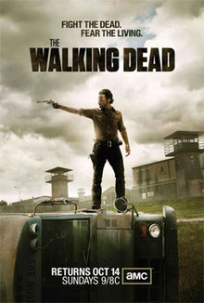
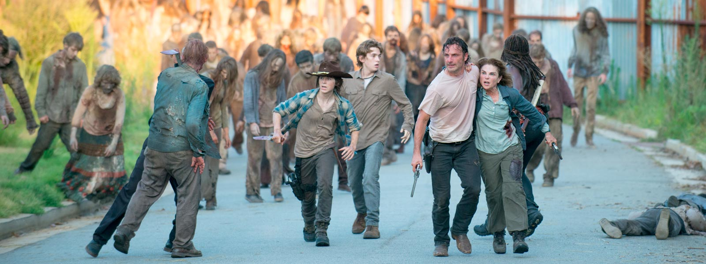
IE 48F THE WALKING DEAD
ALPEREN İNAL 2012402144
MUHAMMED BÜYÜKKINACI 2012402030
26 MAY 2017

Slide 2
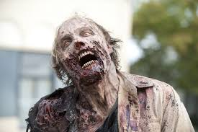
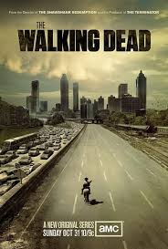
Problem descrIptıon
Zombie related broadcasts
Inspired from The Walking Dead
3 kinds of Agents
Hunters
Food Collectors
Zombies

Slide 3
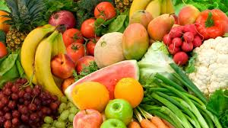
ASSUMPTIONS
Finite Food
Food is Perishable
No regeneration of agents and foods

Slide 4
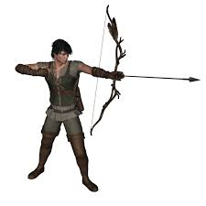

HUMANS
Composing of 2 different Agents
- Hunters
- Food Collectors
Mutualist Relationship
Recovery by food
# of Total Humans fixed

Slide 5
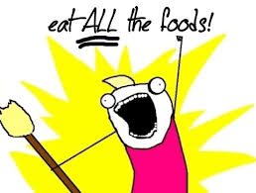
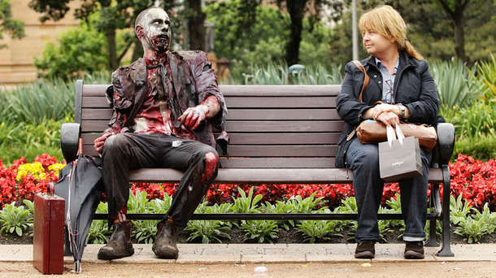
Drawbacks of humans
Starvation
-Stamina decreased per tick
-Hunters suffer more
Zombie Attack

Slide 6
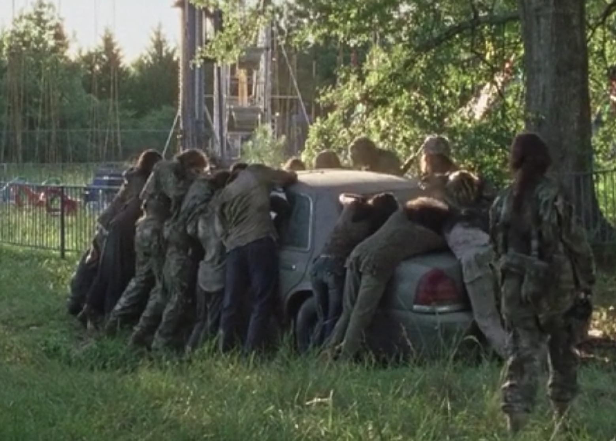
ZomBIES
Attacking Humans
Exposed to Hunters Attack
No Recovery possible by food
No Starvation

Slide 7
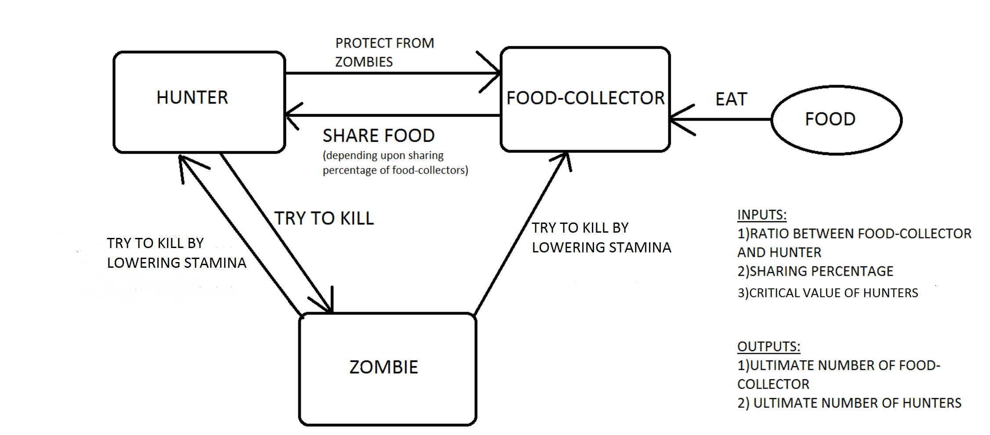
System DIAGRAM

Slide 8

Maın outcome of ınterest
The ultimate number of Zombies
The ultimate number of Humans
Stopping condition: All humans or zombies die

Slide 9
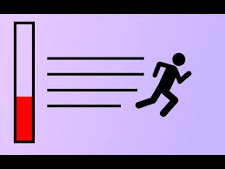
Common characterISTIcS
Stamina
Types – Humans & Zombies
Species - Food-Collectors & Hunters & Zombies

Slide 10
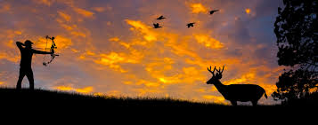
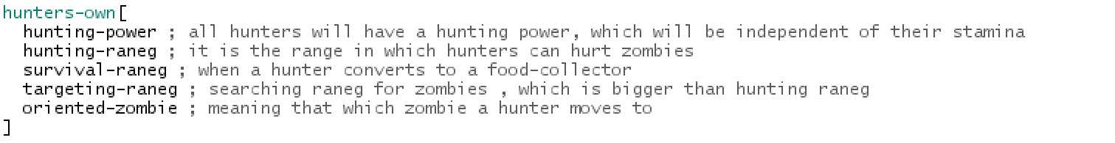
HuntERS
Hunting Power
Hunting-Range
Survival-Range
Targeting Range
Oriented-Zombie

Slide 11
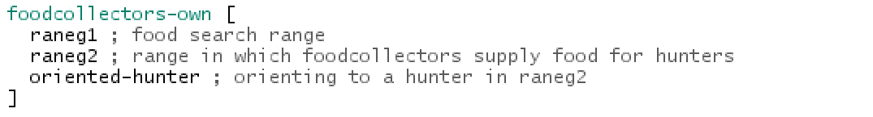
FOOD-COLLECTORS
Food-Search-Range
Food-Supply-Range
Oriented-Hunter

Slide 12
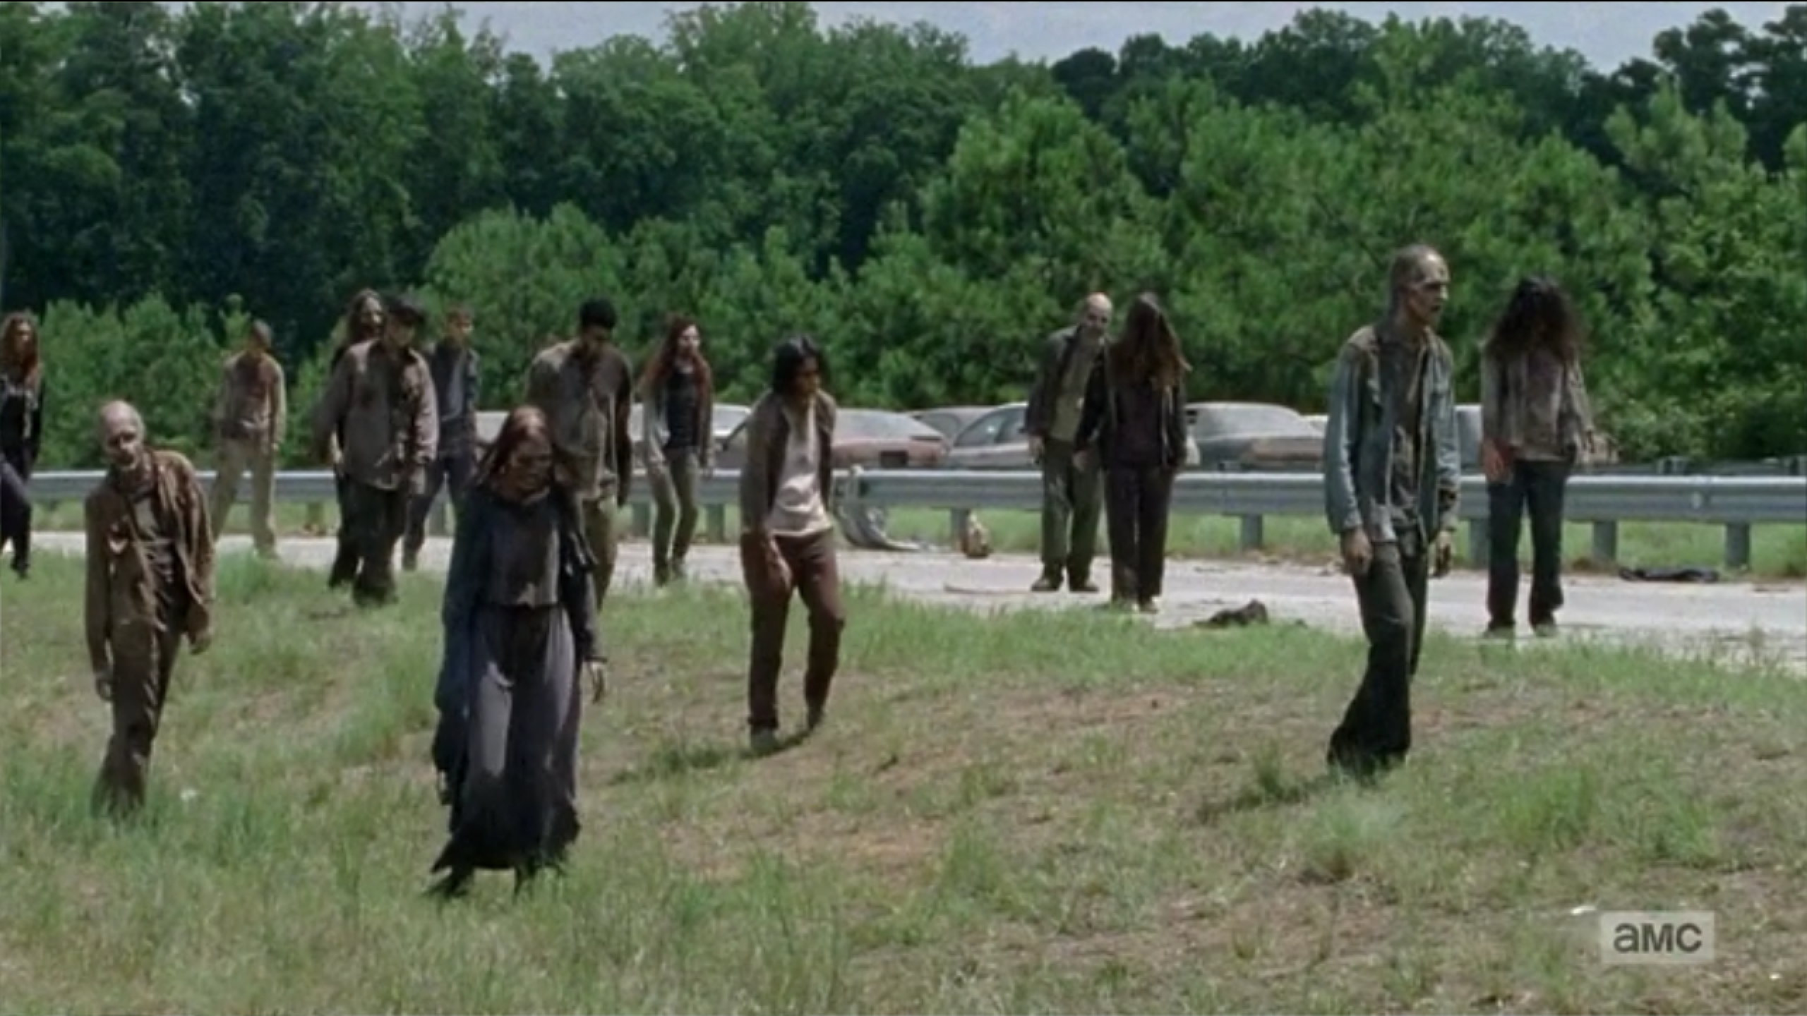
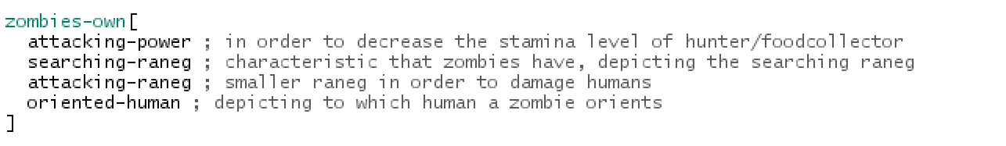
ZOMBIES
Searching-Range
Attacking-Range
Attacking-Power
Oriented-Human

Slide 13
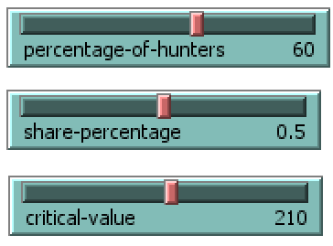
KEY PARAMETERS
Percentage of Hunters
Share-Percentage
Critical -Value

Slide 14
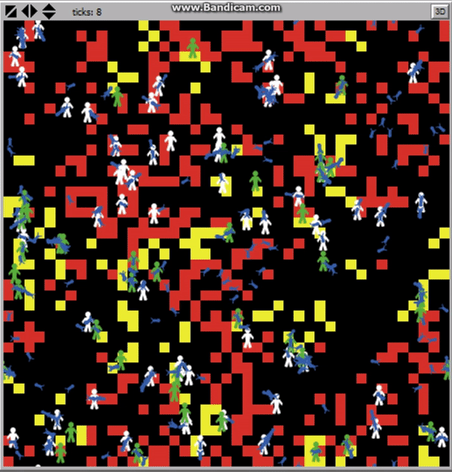

Slide 15

MODELLING QUESTIONS
How does critical value affect the outcome ?
How does food sharing percentage influence the outcome ?
In which way the ratio of hunter to food collector affect the outcome ?

Slide 16
MAJOR PROCEDURES
Zombies
Hunters
Food Collectors
• Searching for Human
• Trying to kill Human
• Searching for Zombie
• Trying to kill Zombie
• Survival search
• Searching for food
• Gathering food
• Searching a Hunter

Slide 17

PROCESS OVERVIEW
Composing of 3 moves
Zombie-move
Hunter-move
Food-Collector-move

Slide 18
ZOMBIE MOVE
If any human in searching range
[ Orient to nearest human ]
else
[ move randomly ]
If any human in attacking range
[Trying to kill human]

Slide 19
HUNTER MOVE
If stamina > critical value
{ Ifelse (any zombie in targeting raneg)
[ Orient to nearest zombie ]
[move randomly ]
If (any zombie in hunting range)
[Trying to kill zombie ] }
Otherwise
{ Survival Search }

Slide 20

FOOD-COLLECTOR MOVE
If (on a food)
[ Take food
Search a hunter
ifelse (any hunter close)
[deliver the food ]
[move randomly ]
]
- else (not on a food)
[ search for food ]

Slide 21
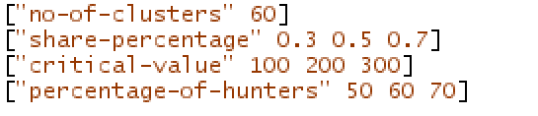
EXPERIMENTATION PLAN
30 replications
3 different levels for 3 key parameters
27 different scenarios
810 runs for each policy
4 policies

Slide 22
POLICIES
Reference Case
Group Movement of Hunters
Group Movement of Zombies
Shelter

Slide 23
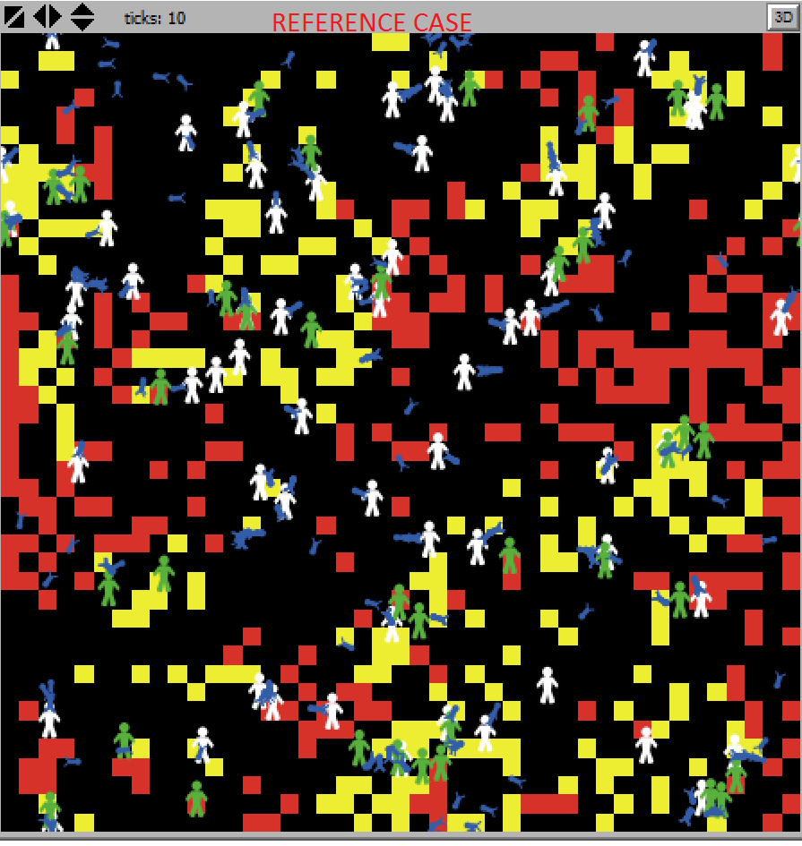
REFERENCE CASE

Slide 24
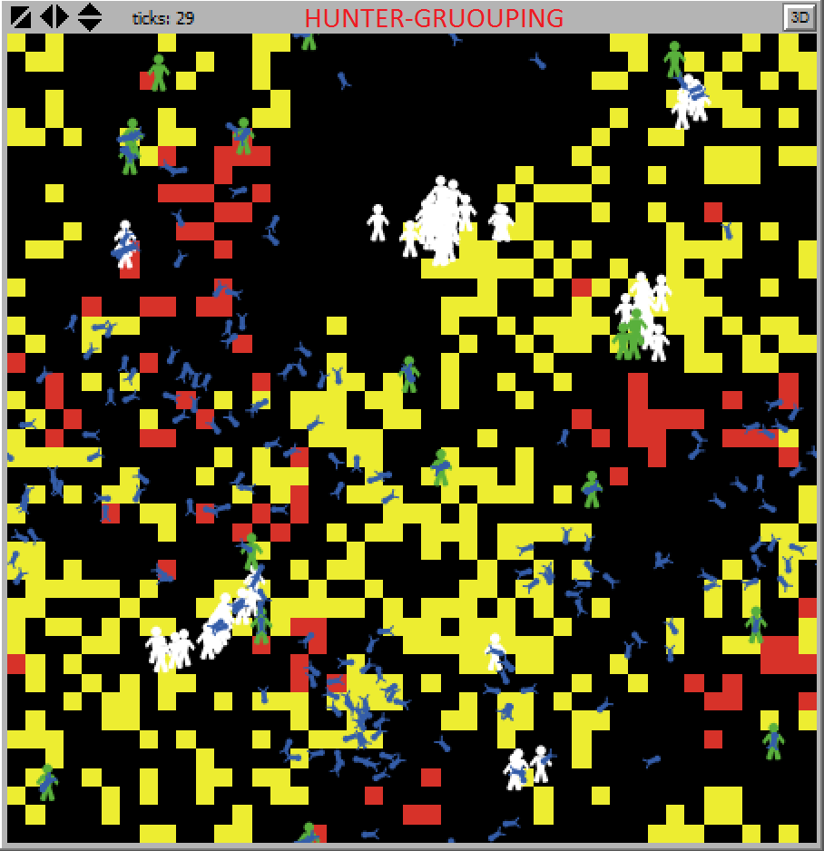
HUNTER GROUPING CASE

Slide 25
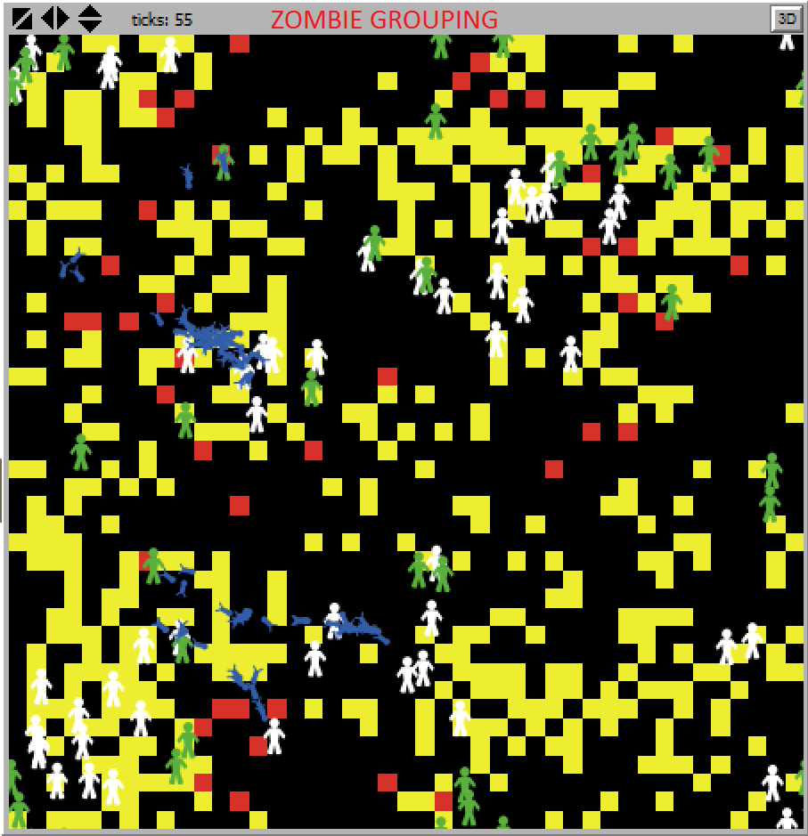
ZOMBIE GROUPING CASE

Slide 26
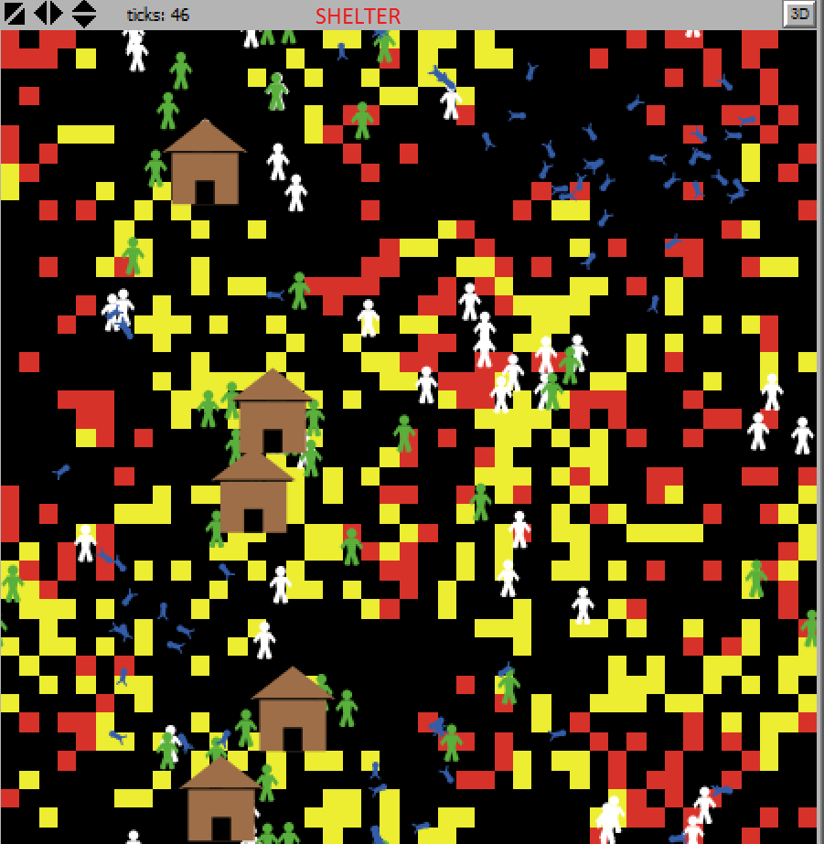
SHELTER CASE

Slide 27
Results
Number of Scenario | Share-Percentage | Critical Value | Percentage of Hunters | Policy 1 | Policy 2 | Policy 3 | Policy 4
1 | 0,3 | 100 | 50
2 | 0,3 | 100 | 60
3 | 0,3 | 100 | 70
4 | 0,3 | 200 | 50
5 | 0,3 | 200 | 60
6 | 0,3 | 200 | 70
7 | 0,3 | 300 | 50
8 | 0,3 | 300 | 60
9 | 0,3 | 300 | 70
10 | 0,5 | 100 | 50
11 | 0,5 | 100 | 60
12 | 0,5 | 100 | 70
13 | 0,5 | 200 | 50
14 | 0,5 | 200 | 60
15 | 0,5 | 200 | 70
16 | 0,5 | 300 | 50
17 | 0,5 | 300 | 60
18 | 0,5 | 300 | 70
19 | 0,7 | 100 | 50
20 | 0,7 | 100 | 60
21 | 0,7 | 100 | 70
22 | 0,7 | 200 | 50
23 | 0,7 | 200 | 60
24 | 0,7 | 200 | 70
25 | 0,7 | 300 | 50
26 | 0,7 | 300 | 60
27 | 0,7 | 300 | 70

Slide 28


